Slide 1

ATTRACTING DIVERSITY TO POLICING SEPTEMBER 2023 NEIGHBOURHOOD WATCH CONFERENCE
Avi Collins & Renee Griffiths
September 2023

Slide 2

Government Security Classification | OFFICIAL
FOIA Exemption | Yes
Suitable for Publication Scheme? | No
Title: | Attracting Diversity to Policing
Storage: | Box
Summary: | Attracting Diversity to Policing – introduction to Outreach and the London Police Race Action Plan
Purpose: | Highlight current strategies within the Met for attracting diversity to policing
Relevant to: | Neighbourhood watch conference, key stakeholders
Owner & Authorising Officer: | Outreach Lead – Chief Superintendent Jeff Boothe
Authors and warrant/pay numbers: | Created by Outreach Deputy Lead – T/ Band B Renee Griffiths & Outreach Lead for AS & SE Avi Collins
Creating B/OCU or Branch and Code: | Professionalism OCU – Outreach Team
Date Created: | 17/09/2023
Sign Off: | Chief Superintendent Jeff Boothe
Review date: | 7 years from date of creation

Slide 3
SETTING THE SCENE
Now
31% of police officers are female
10 years ago
25% of police officers were female
11% of police officers from a BAMEH background
2.7% of police officers from a BAMEH female background
2.7% of police officers from a Black background
17.2% of police officers are from a BAMEH background
4.8% of police officers from a BAMEH female background
3.7% of police officers from a Black background

Slide 4
SETTING THE SCENE
10 YEARS AGO VS. NOW
12% increase in police officers – Now 34,503
37% increase in female police officers – Now 10,565
75% increase in BAMEH police officers – Now 5,889
99% increase in BAMEH female police officers – Now 1,646
49% increase in Black police officers – Now 1,255

Slide 5
CURRENT DIVERSITY STATS
MPS (July 2023) vs London (Census 2021)
MPS
LONDON
Black, Asian and Multiple Ethnic Heritage
Police Officer – 17.2%
Police Staff – 27.5%
PCSO – 40.7%
MSC – 32.5%
46.2%
Black
Police Officer – 3.69%
Police Staff – 10.33%
PCSO – 13.56%
MSC – 6.71%
13.5%
Female
Police Officer – 30.7%
Police Staff – 57.4%
PCSO – 34.8%
MSC – 28.2%
51.5%

Slide 6
DIVERSITY TARGETS
Police Officer Targets
BAMEH – 40%
Female – 50%
Black – 8%
BAMEH Female – 15%
London is a city where the population is changing and growing fast. The Met needs to keep pace and better reflect the communities we serve
Notes:
London is a city where the population is changing and growing fast – with a population that's 51% female, 46% of Londoners are from under-represented communities and the city is home to 270 nationalities and 380 languages.

Slide 7

INTRODUCTION TO THE OUTREACH TEAM
Aims, Structure and how we attract diversity
Build Trust and Confidence
Inform people of opportunities
Inspire people to consider policing career
Support those that act by applying
Notes:
People from under-represented backgrounds bring with them different life experiences to add to the wealth of experience our people already have. To help recruit candidates from diverse backgrounds, we've set up an Outreach team to build confidence in those communities where historically trust has been low; inform people about the fantastic opportunities available within policing , inspire people to be the change they want to see; and support them in actively applying to join the Met.
Led by Chief Superintendent Jeff Boothe, Each BCU has an Outreach Lead, who has responsibility for co-ordinating the joint activity of the BCU resources to effectively engage with communities. Outreach workers make the initial contact with potential candidates, inform and inspire them, with the ultimate aim for them to submit an application form. Once people have submitted an application form, they then go through the recruitment selection.
Avi – Events, insight sessions, pics, newsletter and social media
Renee – COF partners. Over 70, 4.6 million, t&c before. Key successes. Slow burner

Slide 8
CURRENT RECRUITMENT PLAN
Build Trust and Confidence
Genuine and authentic collaboration with different communities in London
Inform
Police Officer, PCSO and staff roles (e.g. forensics)
Inspire
South Cluster example
New Met for London
Building links with Community leaders at NMFL events
Robust Comms. Strategy
Behind the Badge. BCU Commander Trevor Lawry who provided funding last year and will be arranging another one in last quarter of the year.
Support
Application workshops
Insight sessions
London Police Race Action Plan
#BetheChange
Insight sessions
COF partner activity
Met_Connected
JRFT workshops
Notes:
MPS wide, the organisation is struggling to recruit and are currently around 1,000 short of the growth target. Reasons given for this include the buoyant London job market. We also know that levels of trust and confidence in the MPS has been steadily declining from a level of 86% in March 2016 to 71% in March 2023 for ‘Trust in the Police’ and from 68% in March 2016 to 50% in March 2023 for ‘Confidence in the Police’.
In South Cluster Greenwich contributed 10% total applications, 8% BAMEH, 12% female application's , 13% BAMEH female application's , 10% black application's and 13% black female application's. With the success of behind the badge held last year they will be holding the similar type of event focusing in either Lewisham or Greenwich

Slide 9
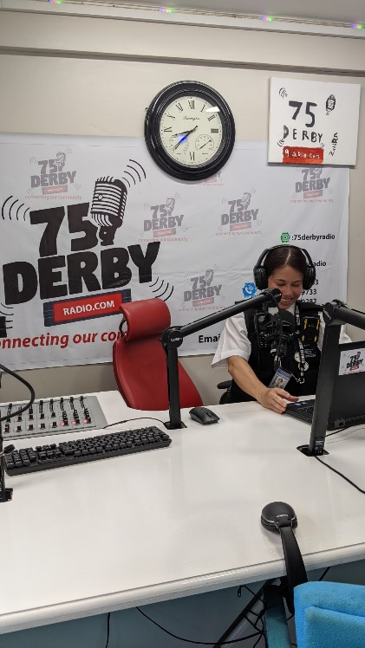
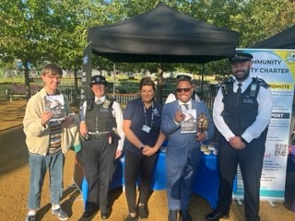
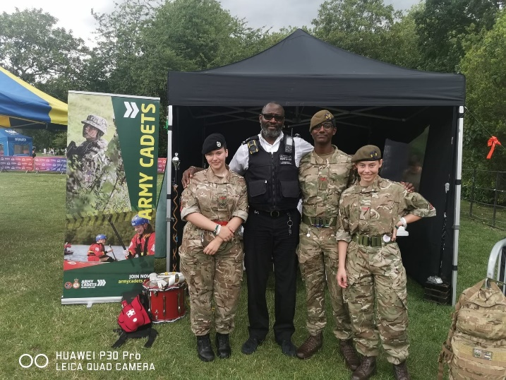
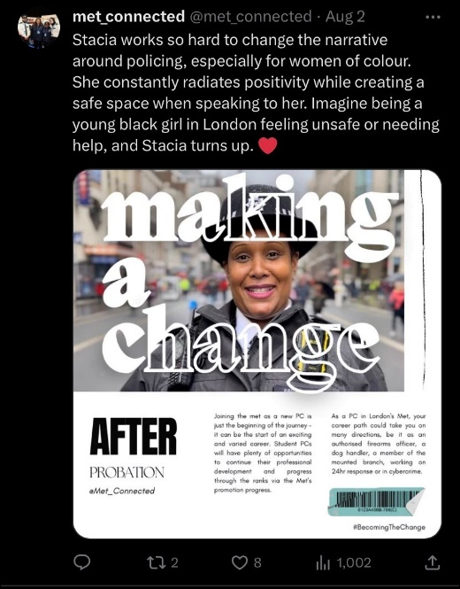
INTRODUCTION TO THE OUTREACH TEAM
Examples of outreach activity include building stronger community links, and this is done through identifying community leaders, key influencers and existing partner agency networks, for example Safer Neighbourhoods Boards, Business Improvement Districts, faith forums, schools, colleges, charities; and then in partnership organising discussion forums to raise awareness of the role of the Outreach Teams. This activity is further supported by online discussion forums and online recruitment events, where the Outreach Teams seek to inform people of the fantastic opportunities available in joining the Met for anyone aged between 18 and 57 years.

Slide 10
TWO YEARS OF OUTREACH
Engagement
Over 28,700 QR codes have been scanned at Outreach Events
Applications
Over 1600 individuals have applied to become police officers via Outreach
Contacts
Diversity of Contacts
Over 10,600 individuals have provided full contact details for bespoke Outreach support
62% Black, Asian or Multiple Ethnic Heritage
44% Female
29% BAMEH Female
28% Black
13% Black Female
Diversity of Applications
57% Black, Asian or Multiple Ethnic Heritage
44% Female
27% BAMEH Female
22% Black
11% Black Female
Met Aspirations are to reach: 40% BAMEH, 50% Female, 15% BAMEH Female, 8% Black
MPS Police Officer Applications currently stand at 40% BAMEH, 35% Female, 13% BAMEH Female and 9% Black

Slide 11
INTRODUCTION TO THE LONDON POLICE RACE ACTION PLAN
Working towards the Met becoming an anti-racist police service
Four overarching areas of work
Workstream 1 - Represented
A police service that is representative of Black people, and supports its Black officers, staff and volunteers.
Workstream 2 – Not over-policed
A police service that is fair, respectful and equitable in its actions towards Black people.
Workstream 3 - Involved
A police service that routinely involves Black people in its governance.
Workstream 4 – Not under-protected
A police service that protects Black people from crime and seeks justice for Black victims.
Notes:
MPS response to the National Police Race Action Plan which was launched in 2022. Policing has had a difficult history in its relationships with Black Communities, and we have much to do to secure the confidence of Black people, including our own staff. Our vision is to have a policing service that is anti discriminatory, and through the effective delivery of the Race Action Plan become anti-racist and trusted by Black people.
• 49.3% of Black people within England and Wales live in London.
• 13.5% of the population in London are Black. Within all other areas of the UK, the next highest proportion is 4.5% in the West Midlands right down to 0.9% in Wales.
• 66% of the Black police officers nationally are employed by the MPS.
Better for all, 1st in series of action plans
LRO and deputies for each area, robust communications plan
Draft plan currently out for initial consultation until the end of September, ongoing process of review and change

Slide 12
OUTREACH & WORKSTREAM 1
OUTREACH ACTIVITY
Community talks with local Black fathers on the topic of how better relationships with the Met could be realised and how could they support recruitment from the community to join the Met – with Black influencer/ community leader
Collaborative Event with Brown Skin Girls Network at NSY, to support recruitment of Black Women
Video seeking to attract young Black males to the Met by COF partner featuring a young Black male as the main protagonist
North Cluster working SYDRC who focus on engagement in Somali community to bridge the gap between the community and the Met Police.
Multiple Faith Events at Black led churches
Black Female Insight Sessions and COF partner recruitment workshops specifically for Black women
Collaboration at numerous events (Black inclusion week, Taste the Caribbean, 75 Windrush, Brown Skin Girls Network
Collaboration with COF partners to hold talks on Black history themes e.g. such as the historical context of black women's bodies, their lack of autonomy and how it related to white men and white institutions.
Working with the Hebe Foundation (5 boroughs and 120 youth that are primarily from a Black background
Somali Youth Group Careers Insight session filmed by the BBC in collaboration with WA Outreach Team, Youth Engagement Team and NPT
Black Inclusion week – filming of black officers, behind the badge and day in the life
Youth questionnaire being compiled by NW in line with LRAP objectives to be disseminated at events

Slide 13
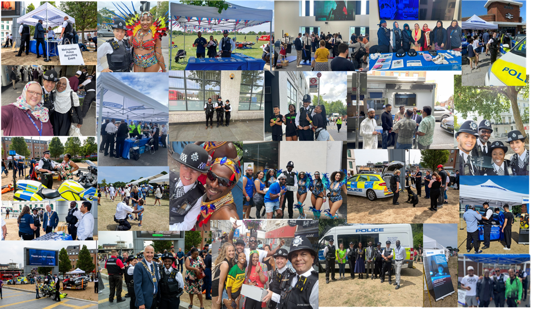
QUESTIONS?

