Slide 1
How to become a member and join your local group

Slide 2
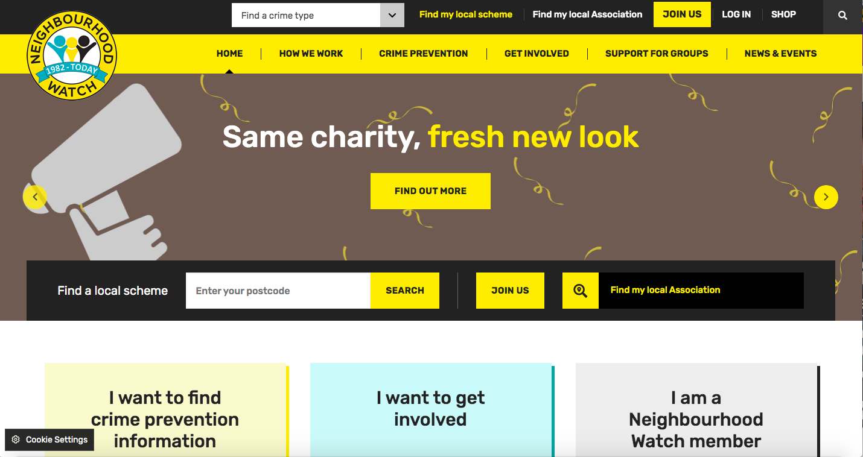
Step 1
Visit our website: ourwatch.org.uk
Click on JOIN US
See the top right hand corner

Slide 3
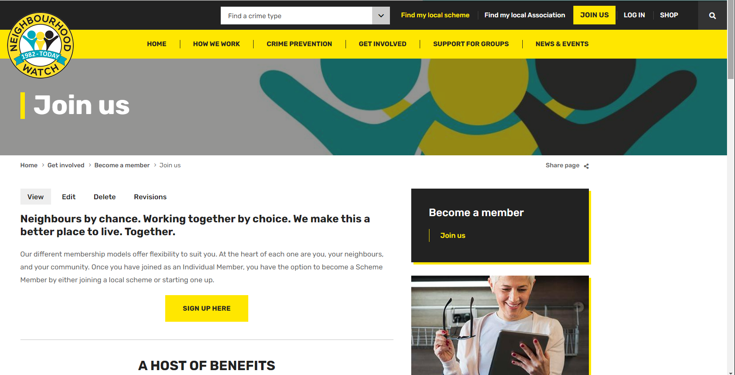
Step 2
Scroll down
Click on:
SIGN UP HERE

Slide 4
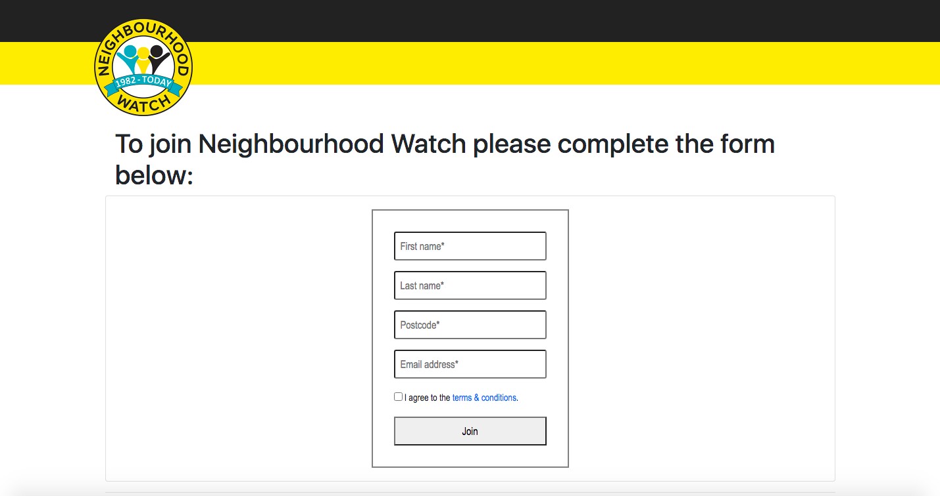
Step 3
Fill in your first name, last name, postcode and email address
Confirm that you accept the terms and conditions
Click JOIN

Slide 5
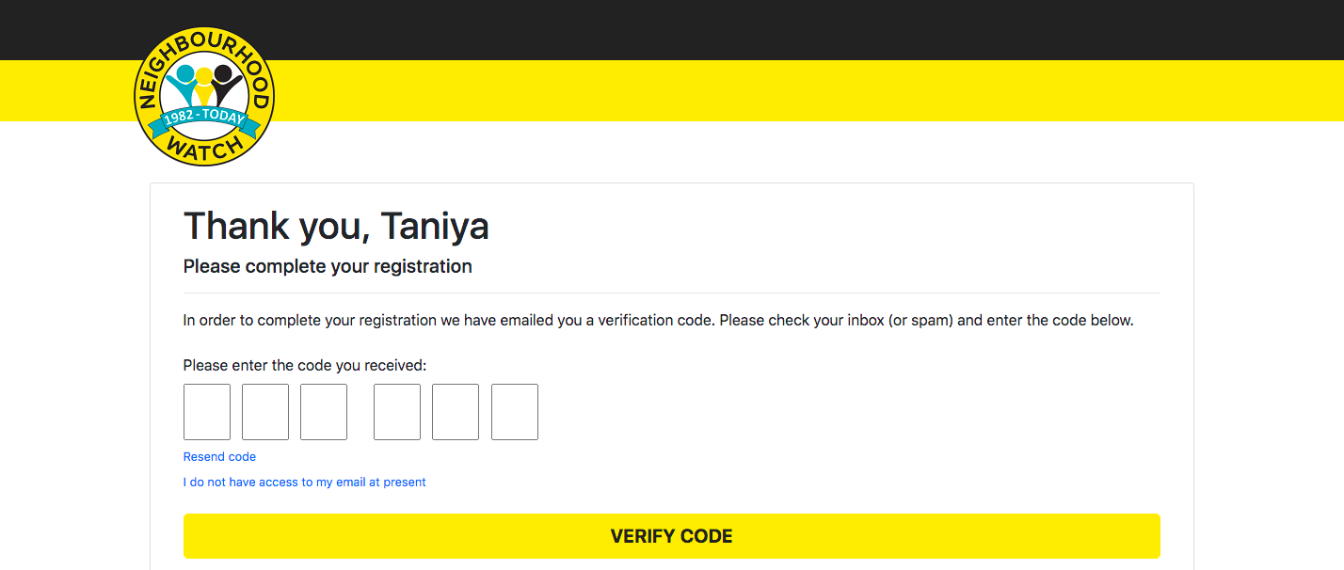
Step 4
Answer the security question
Enter the verification code from your email inbox
Click VERIFY CODE

Slide 6
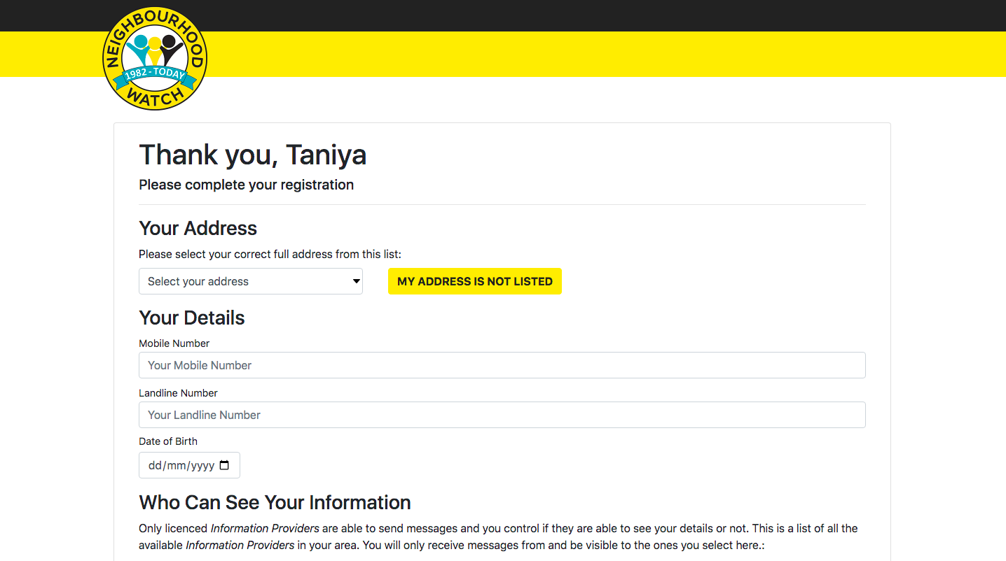
Step 5
Confirm your address from the dropdown list
Enter your contact numbers
Enter your date of birth

Slide 7
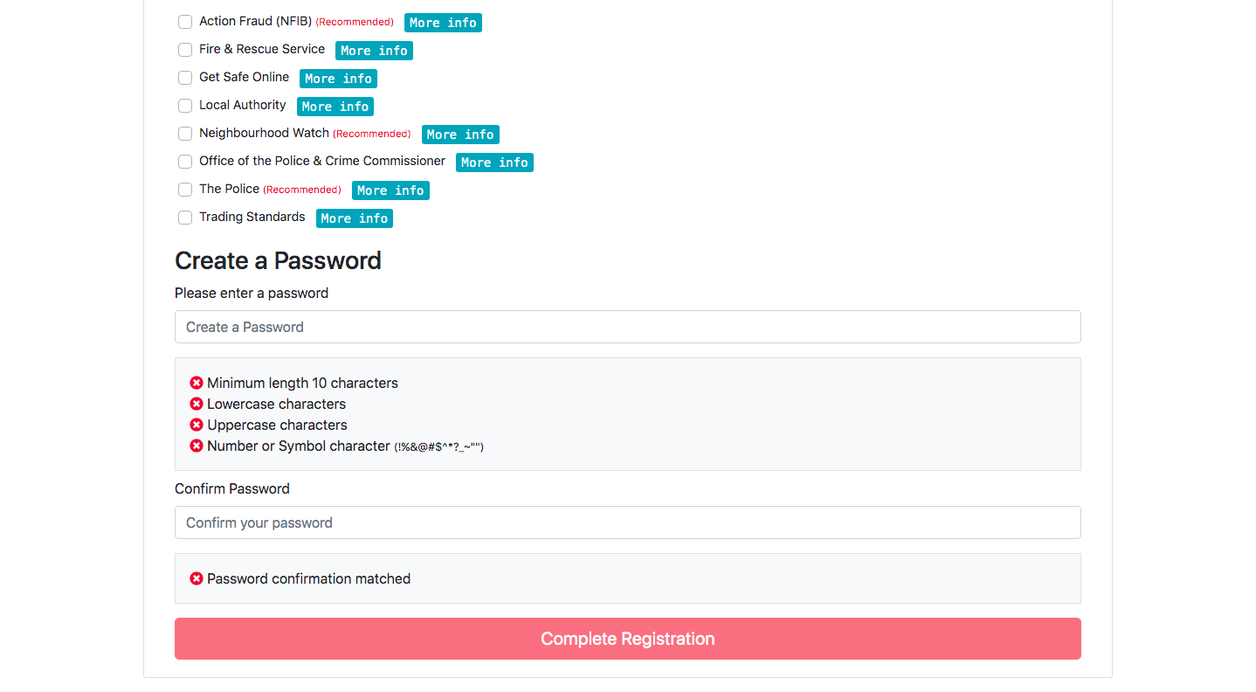
Step 5 continued
Tick the organisations you wish to receive information from
This also selects which organisations can see the data you have provided
Create a strong password
Once you have finished, click on COMPLETE REGISTRATION

Slide 8
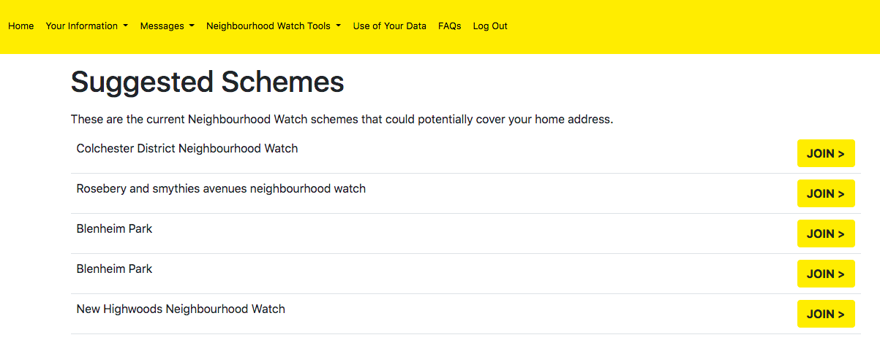
Step 6
You will be automatically directed to Join your local scheme
If there are existing Neighbourhood Watch schemes in your area, they appear here. Click JOIN to sign up
If there are no schemes that cover your local area, you may consider creating your own. If so, click:
CREATE A NEW SCHEME

Slide 9
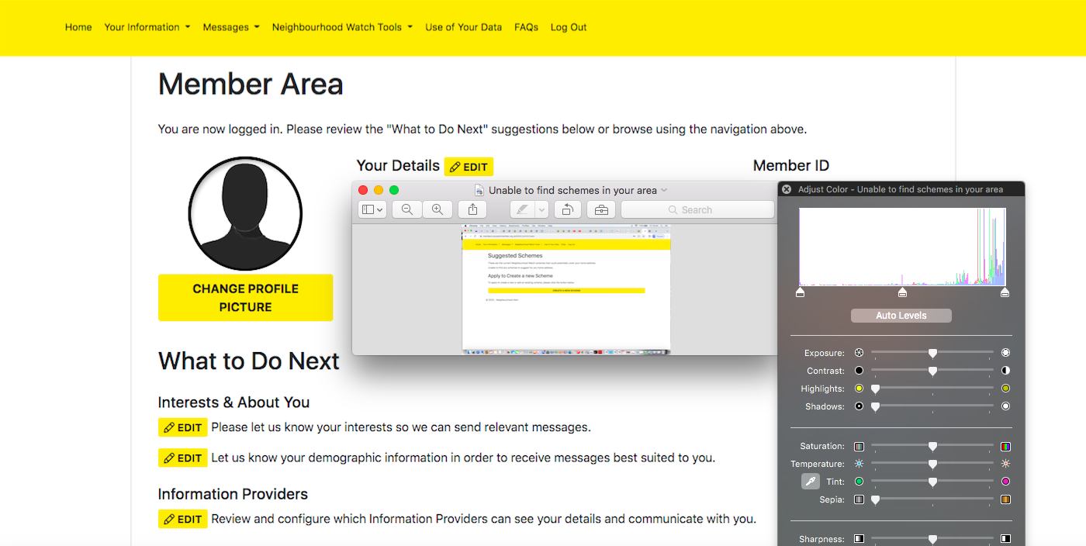
Member Area
Click on Home in the top left hand corner of your screen to visit the Member Area
Here you can join or create a scheme if you haven’t already
You can also edit your details, share your interests, and review your settings

Slide 10
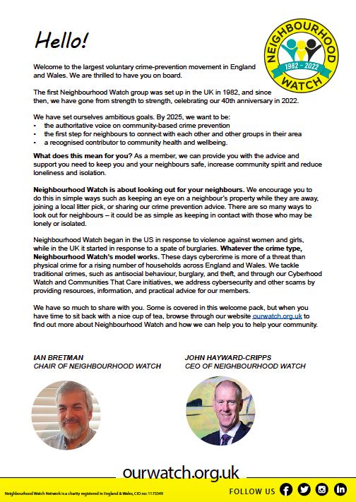
Welcome on board!
Once you have registered, you will receive your New Member Pack by email

Slide 11
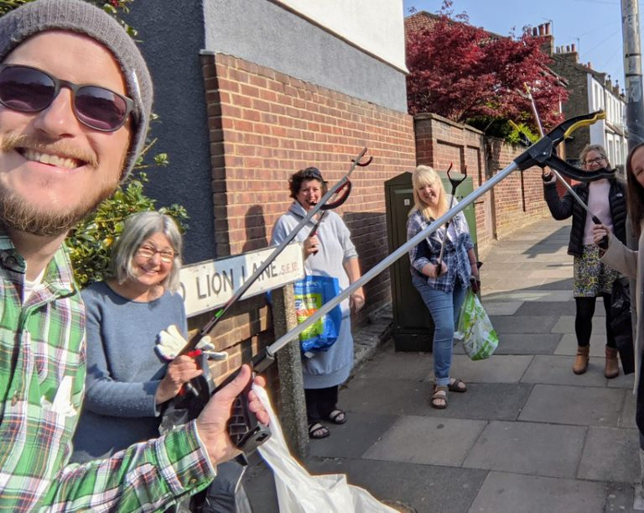
I’ve joined a scheme – what happens next?
Your local scheme Coordinator should make contact with you to introduce themselves and welcome you into the scheme.
Many schemes run events such as coffee mornings and crime prevention talks, as well as litter picks and get togethers.
Joining and being part of an active scheme can bring the community together, build resilience, and improve your community’s wellbeing, as well as reducing opportunities and fear of crime.

