Slide 1

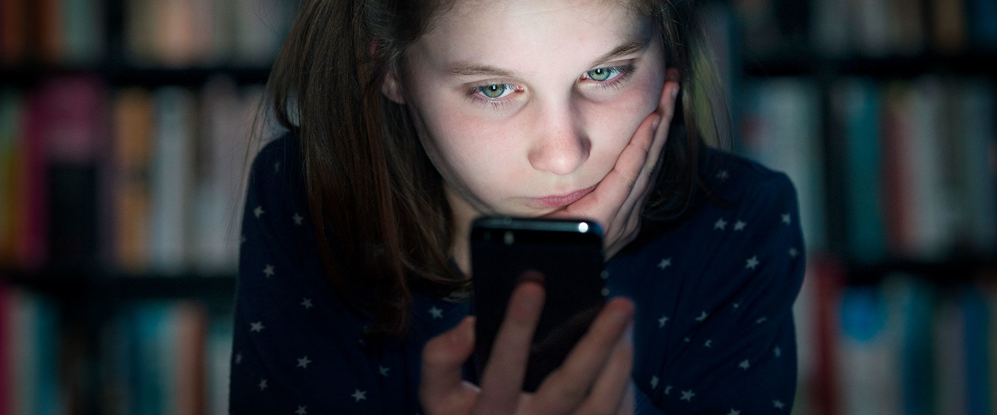
CHILD SEXUAL EXPLOITATION
“The sexual abuse and exploitation of children is one of the most vicious crimes conceivable, a violation of mankind's most basic duty to protect the innocent.”
James T. Walsh

Slide 2

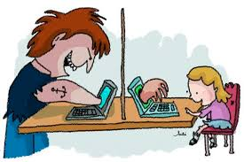
WHAT IS IT?
Child sexual exploitation is a type of child sexual abuse involving the manipulation or coercion of people under 18 into sexual activity.
Children may be promised or plied with money, gifts, favours, attention or safety and protection from violence in exchange for engaging or submitting to sexual acts or allowing sexual acts to be performed on them.
Some children are tricked into believing they are in a loving, consensual relationship with their abuser. They might be invited to parties and given alcohol or drugs. They may be groomed and exploited online.

Slide 3
A HIDDEN CRIME
Child sexual exploitation can often be a hidden crime because even though it is often committed in plain sight, it can be under-identified or not acted on by adults. Children often trust their abuser and don’t realise they are being exploited.
They may depend on their abuser or be too scared to escape from them or tell anyone what’s going on.
Some young people are trafficked into the UK in order to be sexually exploited, others are trafficked within the UK, moved from place to place in order to be abused again and again.
Children, both boys and girls involved in gangs are also frequently forced into sexual activity, possibly as an initiation or where sexual favours are demanded in exchange for status or protection.

Slide 4
WHERE AND BY WHO?
Perpetrators operate in all parts of the country, in cities, towns and rural areas, and are known to target young people in a range of locations including schools, neighbourhoods, parks, houses, hotels, takeaways, retail and entertainment outlets and online.
Approximately one third of sexual exploitation is committed by other children under the age of 18 years. These young people who have harmful sexual behaviours are often victims of trauma and abuse themselves including domestic abuse, physical abuse, chronic neglect and sexual abuse.
Sexual exploitation has profound and damaging consequences for the individuals exploited and those around them, particularly families and communities.

Slide 5
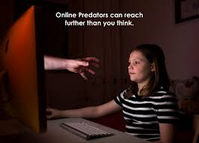
ONLINE CHILD SEXUAL ABUSE
send or post sexually explicit images of themselves
take part in sexual activities via a webcam or smartphone
have sexual conversations by text or online
be livestreamed whilst being sexually abused
Abusers may threaten to send images, video or copies of conversations to the young person's friends and family unless they take part in other sexual activity.
Images or videos may continue to be shared long after the sexual abuse has stopped.
When sexual exploitation happens online, young people may be persuaded, or forced, to:

Slide 6
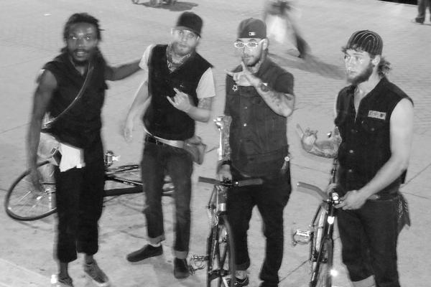
EXPLOITATION IN GANGS
exert power and control over members
initiate young people into the gang
exchange sexual activity for status or protection
entrap rival gang members
inflict sexual assault as a weapon in conflict.
Most sexual exploitation within gangs is committed by teenage boys and men in their twenties. Younger boys can often be forced by older peers to sexually assault and harm other boys or girls.
The gang model of child sexual exploitation may involve peers recruiting young people, often girls, into the gang. Peer recruiters will be male or female and will often have been exploited themselves.
Children are frequently forced into sexual activity by gang members. Violence will usually be involved. Sexual exploitation is used in gangs to:

Slide 7
PREVALENCE
There is no specific crime in law of child sexual exploitation; offenders are generally convicted of associated crimes such as sexual activity with a child. Accordingly, there are no national figures on child sexual exploitation offences.
The hidden nature of the crime also makes it difficult to find a reliable source of prevalence data. Children and young people rarely report their experiences of this type of abuse. However,
18,700 victims were identified by councils in 2018/19…
…up from 3,300
five years before

Slide 8
WHAT’S BEING DONE?
Barnardo’s and NSPCC both provide services to support children and young people affected by sexual exploitation. Barnardo’s has worked with affected children for 20 years, and has specialist services in over 40 locations.
The government is working with local authorities to introduce rigorous taxi and private hire licensing regimes. Taxi drivers have been linked to several recent cases of child sexual exploitation.
Hotel Watch is a scheme that has been set up in many towns and cities to allow police and hotels to share information about suspected exploitation of children. Evidence suggests that hotels are often used as locations where perpetrators meet, groom and abuse children. Hotel receptionists, staff and managers are in a unique position to notice if guests seem suspicious or something doesn’t feel right.

Slide 9
SPOTTING THE SIGNS
Because the perpetrators of child sexual exploitation exert such power over their victims, even to the point where the child does not realise he or she is being exploited, it can be hard to know if a child is in danger.
Equally, it can be very difficult to separate the signs that someone is being sexually exploited from much normal teenage behaviour.
However, there are certain signs to look out for that might indicate a child or young person you know is being exploited.
Use ABC to spot the signs. These are changes in a child’s Appearance, Behaviour and Communication.
Indicators can include:

Slide 10
APPEARANCE
Changes in appearance, such as new clothes, more make-up, sudden weight loss, or weight gain
Consistently poor hygiene
Trying to hide marks or scars on their body, either self-harming or injuries inflicted by others
Having money, mobile phones, credit for mobile phones, SIM cards, jewellery, clothes or other items that they cannot or will not explain

Slide 11
BEHAVIOUR
Absence from school, dip in school attainment
Drug or alcohol misuse
Involvement in offending
Regularly coming home late or going missing overnight or longer
Not mixing with their usual friends
Developing a relationship with an older person or hanging out with older people
Association with gangs or use of gang language and terminology
Unusual relationships with taxi drivers or firms
Increased health (headaches, tiredness, digestive problems) or sexual health problems, possibly including repeat pregnancies and terminations or STIs.
Secretive online activity

Slide 12
COMMUNICATION
Breakdown in relationship with trusted adults
Obsessive communication with one or two individuals
Being defensive about where they have been and what they were doing
Being secretive or withdrawn
Talking aggressively or using sexual language

Slide 13

DfE CAMPAIGN
Animated GIF

Slide 14

DfE CAMPAIGN
Animated GIF

Slide 15
OPENING A DIALOGUE
None of these signs definitively means that a child is being exploited. However, noticing changes like those above enables you to open a dialogue with a child. Telling them that you are concerned about their safety and asking them what is happening for them can be the first step to getting them out of their bad situation. Many children have told Barnardo’s that they tried to disclose what was going on for them through behaviour and words but that nobody really understood.
Also, experts agree that having early conversations about healthy relationships and consent is key to stopping young people getting involved in exploitative relationships. The Department of Education has some good advice for parents about how to have these conversations with children from a young age….

Slide 16
TALKING TO CHILDREN
Talking to your child about abuse and exploitation probably isn’t your go-to conversation topic when you’re spending time with them. However, simply talking about the topic is a good way to teach your child how to stay safe.
Don’t use strange new words or present scary scenarios, just have ongoing chats with your child. Here’s how:
Start talking early
You know your child better than anyone, including when they’re ready to start understanding what abuse and exploitation is and how much detail to go into.
You can usually start explaining some simple concepts from the age of four, such as:
Nobody is allowed to do anything to us that we don’t want them to

Slide 17
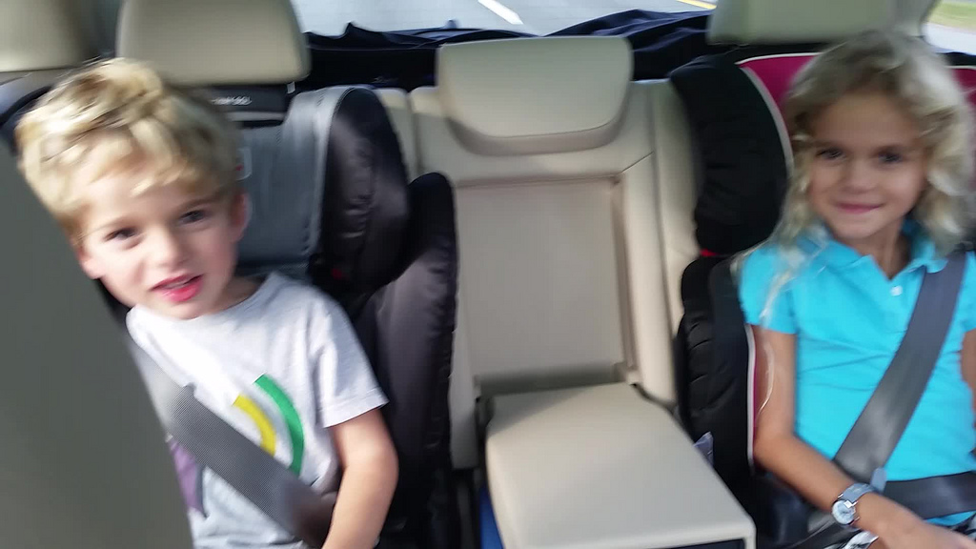
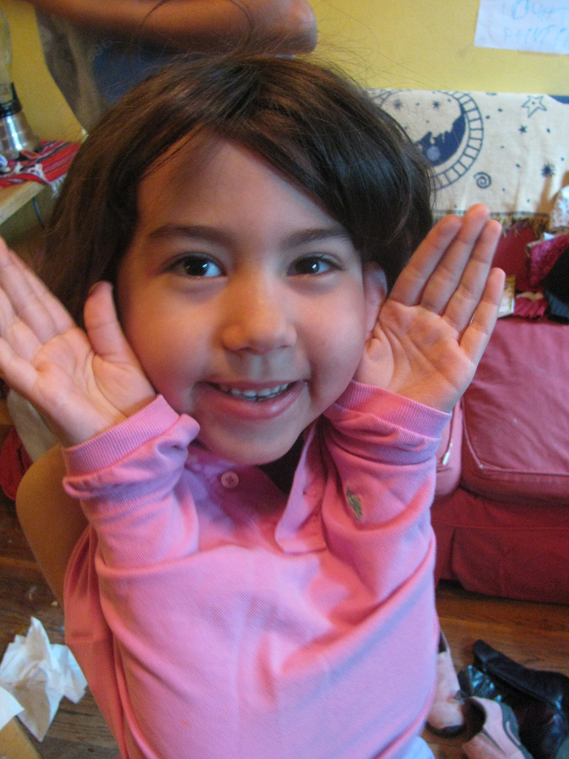
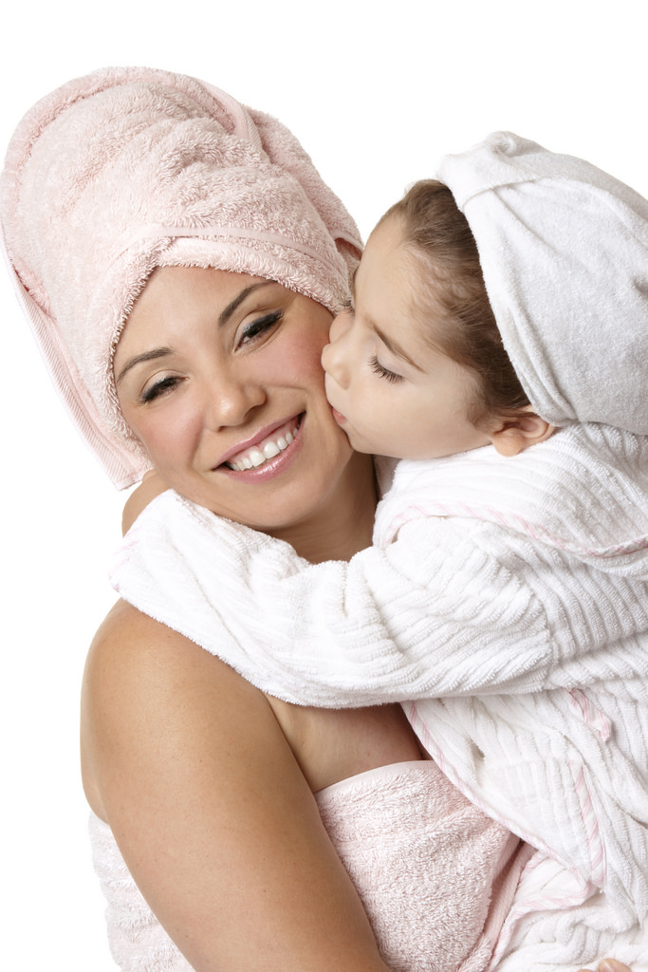
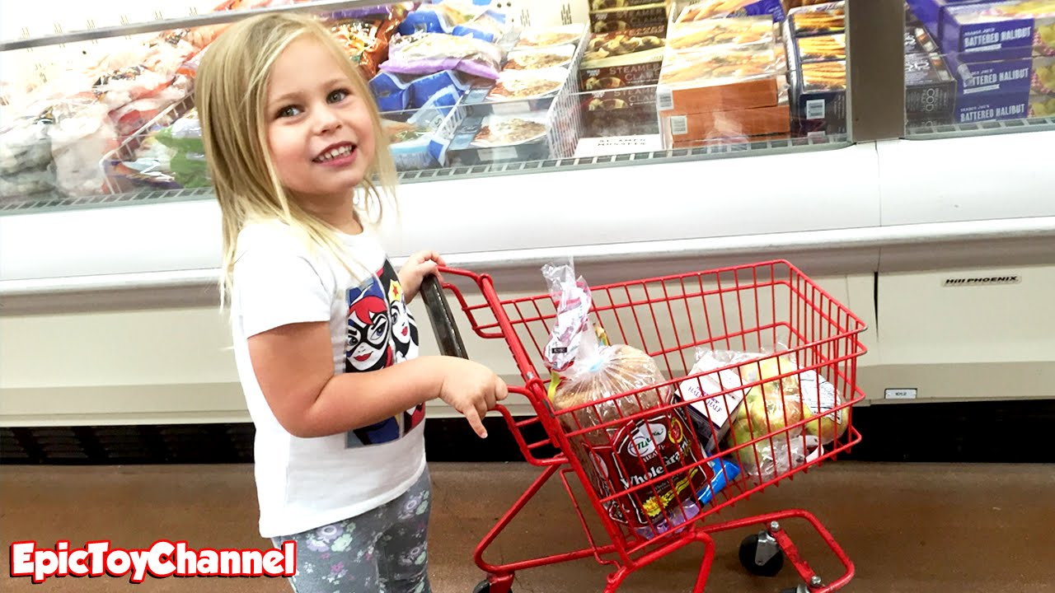

TALKING TO CHILDREN
Getting your child dressed
For slightly older children, a storyline on a soap opera or TV drama can be a good starting point to talk about healthy relationships, boundaries, consent and staying safe - without personalising the conversation.
Pick your moments
Some good times to chat are:
On
car
Journeys…
On a trip to the shops
At bathtime…

Slide 18
TALKING TO CHILDREN
Little and often
Just as with any parenting message, it works best to present a steady drip-drip of information and advice, and make lots of opportunities to chat openly over a period of time - not just a one-off talk that may leave your child confused or embarrassed and with more questions.
Try to avoid a big lecture and keep having mini-conversations every so often to ensure they are happy, safe and well-informed.

Slide 19
INFO FOR CHILDREN
Barnardo’s has created a website called Real Love Rocks, described as an online space all about raising awareness around child sexual exploitation and what a healthy and safe relationship is. It has sections for parents, professionals and young people themselves. Google ‘Barnardo’s Real Love Rocks’ to find it.
CEOP has made an interactive film called First to a Million, which is aimed at 13 to 18-year-olds and follows a group of teens in their battle to reach a million views online by making increasingly outrageous films. At each step the viewer gets to choose what the characters do next, teaching teens how easy it is to end up in a risky situation. Google ‘First to a million’ to find it on Youtube.
The NSPCC has made an animation about a girl taken in by her ‘boyfriend’ Jay. Google ‘NSPCC – the story of Jay’ to find it on Youtube.

Slide 20
INFO FOR PARENTS
NSPCC has lots of online resources to help parents keep their kids safe on the internet. The ‘Share Aware’ section on their website contains advice about how to talk to children about staying safe online, exploring their online world together, managing their settings and controls, and agreeing rules for what’s ok and what’s not. Google ‘NSPCC Share Aware’.
CEOP has produced some useful films that explain the motivation behind young people’s sharing of nude selfies, and how to tackle the issue with your children. Google ‘Nude selfies – a parent’s guide’.
The Lucy Faithfull Foundation has a website called Parents Protect, with lots of resources for parents. Find it at www.parentsprotect.co.uk.
PACE (Parents Against Child Sexual Exploitation) is a charity founded by the parent of a young person who became a victim of sexual exploitation. It offers help and support to affected parents so that they can respond effectively to their child’s situation. Their website is www.paceuk.info.

Slide 21
RISK FACTORS
Sexual exploitation can happen to any young person – whatever their background, age, gender, race or sexuality or wherever they live. Research shows us that there are only 2 definitive and a further 1 likely factor that increases risk. These risk factors are:
Disabled children
Children who have been in the care system or are care leavers
Children who have previous experience of sexual abuse

Slide 22
RISK FACTORS
There are other patterns that can be seen in practice, that have not yet been evidenced but may be important indicators of additional vulnerability. These include:
Living in a chaotic or dysfunctional household
Lacking friends the same age
Recent bereave-ment or loss
Going to school with other young people who are exploited
Links
to gangs
Being homeless
A history of abuse or neglect
Low self-esteem or self-confidence
Being a young carer
Living in a hostel, B&B or foyer

Slide 23
NO ONE IS IMMUNE
However, although evidence suggests that certain life experiences may increase vulnerability to child sexual exploitation, no child or young person is immune from this form of abuse.
The charity Barnardo’s says that children most commonly identified as being sexually exploited are between the ages of 13 and 15, but younger victims are being targeted all the time, especially in relation to online exploitation.

Slide 24

THE STORY OF JAY
A short film by the NSPCC

Slide 25
DISCLOSURE OF ABUSE
If you’re in a situation where your own or another child tells you they’re being abused or exploited, you should:
Listen carefully
Avoid passing opinion
Tell them you believe them
Make sure they know the abuse is not their fault
Reassure them they have done the right thing by opening up to you
Tell them you will help them
Explain what you’ll do next – it’s important to be open and honest about next steps
Report the abuse immediately, either to your local council, the NSPCC or the police. You can remain anonymous when you report your concerns about a child or young person if you’d prefer.
We all have a role to play in keeping children safe. If you think it, report it.

Slide 26
WHAT CAN YOU DO?
If you are worried about the way a child or young person is behaving, or they are displaying some of the signs listed then call your local Children’s Social Care service or the police on 101.
Call 999 if the child is at immediate risk.
If you are concerned about online illicit images of children or online exploitation you can contact Child Exploitation and Online Protection Centre at www.ceop.police.uk/safety-centre.
Or you can call the NSPCC professionals helpline on 0808 800 5000 who can explore your concern and advise you on the best course of action. You can also email them at help@nspcc.org.uk.

Slide 27
THANK YOU
For more information please see
https://www.ourwatch.org.uk/crimes-archive/child-sexual-exploitation/
THANK YOU FOR LISTENING

