Slide 1
Neighbourhood Watch
A short guide of how to join in the movement

Slide 2
What is Neighbourhood Watch?
Neighbourhood Watch is the largest Crime Prevention volunteer organization in England and Wales, with over 2.3m members.
We work within our local communities to increase the value of neighbourliness, community and resilience
We help reduce crime and the fear of crime by providing crime prevention advice and acting upon it.
We work in partnership with policing, councils and community groups to achieve our goals

Slide 3
What are the basic roles?
Individual member
receive updates and newsletters via our messaging service
Member of an existing scheme
feel part of the community by joining other neighbours for a common objective
Coordinator - Start a scheme
bring your neighbours together
build and strengthen your community
make your community more resilient
Liaises with community partners

Slide 4
The joining process
Become a member
This will then enable you to choose to:
Stay as an individual member
Join a local scheme as a member
Start a new scheme as a coordinator
Visit
Visit www.ourwatch.org/join

Slide 5
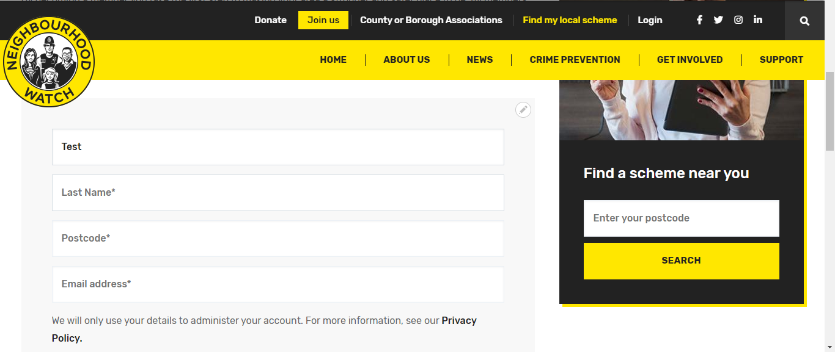
Joining up through OurWatch website
https://www.ourwatch.org.uk/join
Scroll down page and complete the fields, agree the privacy policy and then click to say you are not a robot

Slide 6
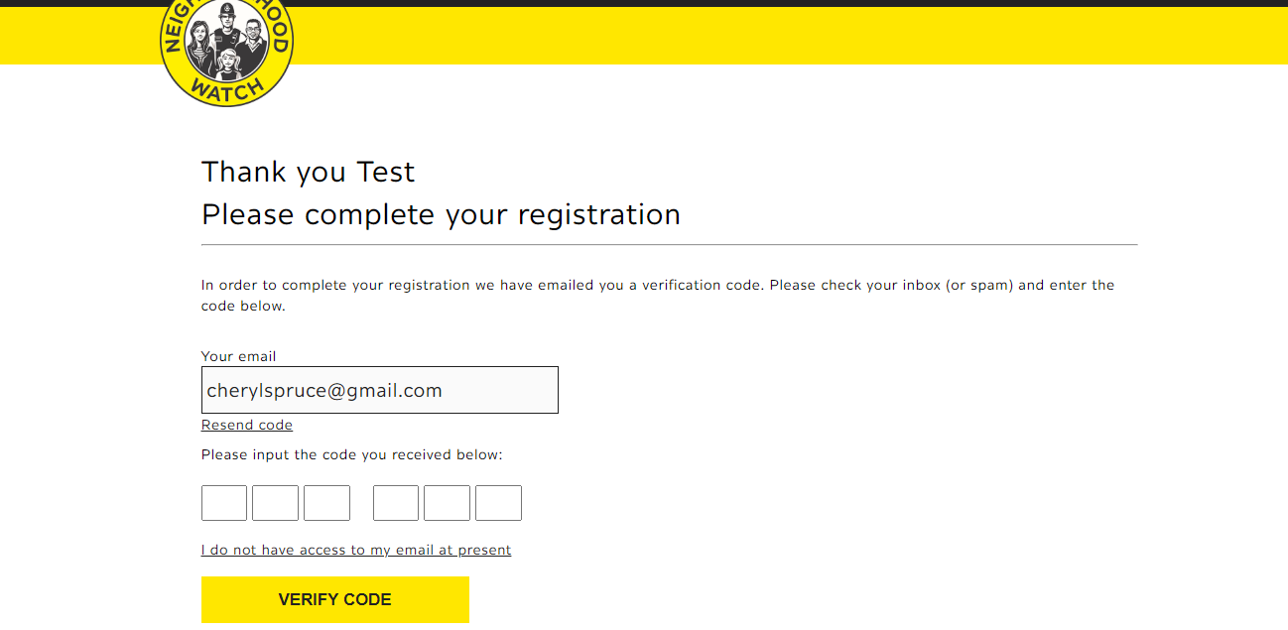
Complete 1st stage
You will receive this email
with the code to enter

Slide 7
Completing your registration
Complete the process by filling in the fields

Slide 8
Registration complete – you are now a member

Slide 9
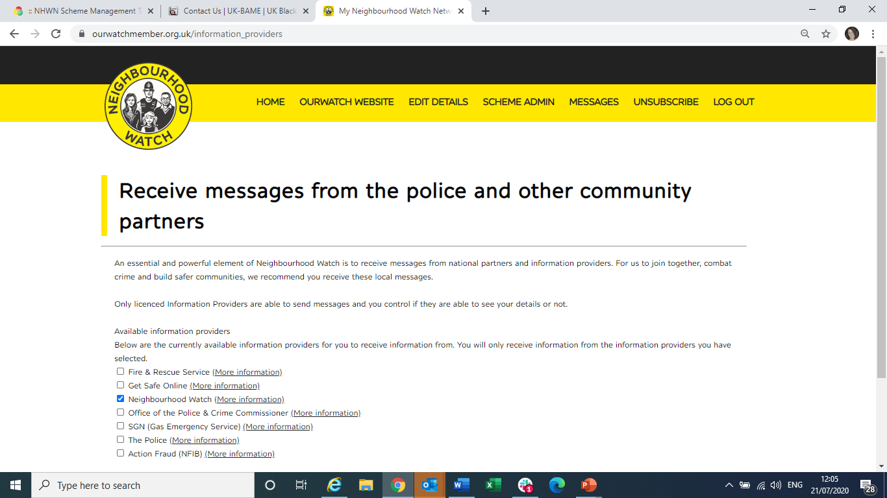
Choose your preferences to receive information

Slide 10
Member Admin Area
This is your member area.
Click on SCHEME ADMIN to join or start a scheme

Slide 11
Joining or create a scheme
Click here to see a list of local schemes in your area – select scheme that you want to join and click APPLY TO JOIN SCHEME
Scroll down to start a scheme. At bottom click on click here to start a new scheme

Slide 12
Starting a new scheme
Insert Scheme Name – Road or area plus postcode

Slide 13
Mapping your scheme
Mapping your scheme means that users will be able to find your scheme using their postcode and your scheme will show on our website.
Click on the dotted box to start your mapping of your scheme. Click where you want to start and drag the curser to the next point to draw a box/shape that reflects your scheme area. Only cover the area that your scheme is in, if you only do one side of the road, then only select that one side.

Slide 14
Complete scheme registration
Complete the fields, add a scheme description about the scheme, not about you

Slide 15
Information about the coordinator
This is where you fill in about the coordinator. You can also choose not to have these details shown to the public.
Once completed click on CREATE SCHEME

Slide 16
Joining and adding a scheme is now complete

