Slide 1


YOUTH LONELINESS & ISOLATION
“Young people – those aged 16 to 24 – are more likely to report feelings
of loneliness than any other age group.”
Office for National Statistics

Slide 2
THE EVIDENCE
Feelings of loneliness are becoming more prevalent among young people. ChildLine carried out 4,636 counselling sessions for loneliness in 2017/18 – 14 per cent more than in 2016/17
Research by the Office of National Statistics in 2018 to measure loneliness found it was the youngest age group, 16 to 24-year-olds, who were most likely to experience loneliness
An Action
for Children survey in 2010 of 3,000 8-12 -year-olds found that a third said they had seen children who didn’t seem to have any friends
According to the Loneliness Experiment conducted by the BBC and the Wellcome Collection in 2018, in which 55,000 people participated, 40 per cent of people aged 16 to 24 admitted to feeling lonely often or very often

Slide 3
WHAT IS LONELINESS?
It’s less about the number of friends you have and more about how you feel.
Some people are happy to spend a lot of time alone, while others may be part of a large social circle but still feel isolated and alone.
Public Health England definitions:
Social isolation
The inadequate quality and quantity of social relations with other people at the different levels where human interaction takes place (individual, group, community and the larger social environment)
Loneliness
An emotional perception that can be experienced by individuals regardless of their breadth of their social networks

Slide 4

ALWAYS A PROBLEM?
It is normal for people to feel left out and lonely sometimes. Most people do from time to time.
But it becomes a problem if such feelings persist and take over.

Slide 5
WIDER IMPACTS
Regularly experiencing social isolation and loneliness can have serious long-term effects for people, affecting their mental and physical health and their risk of mortality.
According to Public Health England, children who are isolated in childhood tend to have…
Worse educational outcomes and go on to get lower-paid and less satisfying jobs
Higher likelihoods of smoking, obesity and psychological distress in adulthood.
Chronic loneliness can be as bad for your health as smoking 15 cigarettes a day.
Samaritans cites an association between suicide and loneliness, with most young people who have suicidal thoughts saying that loneliness plays a significant role in these.
Social isolation and loneliness can also be a key factor in making young people more vulnerable to becoming a victim of crime, abuse or exploitation.
So, successful interventions to tackle social isolation reduce the burden on health and social care services, providing an economic benefit as well as a social one.

Slide 6
WHO IS MOST AT RISK?
Loneliness is not about personality, but more likely to be driven by factors such as health or economic status.
Children who do not conform to local norms of appearance, language or behaviour may face difficulties integrating into peer groups at school, potentially leading to social isolation and a greater risk of being bullied.

Slide 7





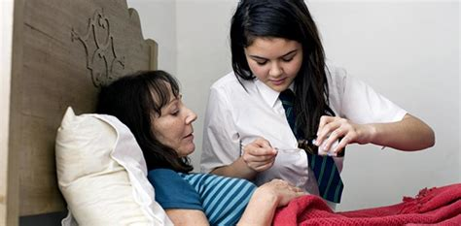
WHO IS MOST AT RISK?
In conclusion, studies show that children and young people can be at greater risk of social isolation and loneliness if they:
Are in or leaving care
Are recently bereaved or ended a relationship
Show signs of neglect or have difficult family relationships
Are overweight or obese
Are disabled or have a long-term health condition
Are a young carer

Slide 8


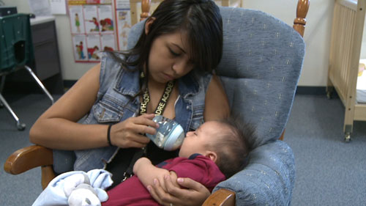



WHO IS MOST AT RISK?
Or, if they….
Recently changed schools
Recently moved to university or higher education
Are being bullied because of their sexuality or ethnicity
Are a young parent
Are not in education, employment or training
Suffer from mental health problems

Slide 9
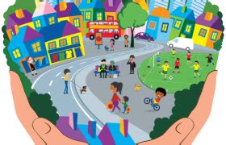
HOW TO HELP
Various charities have produced advice about how to approach the problem of loneliness among children and young people in local communities. Here are some suggestions:
1. Define your local loneliness issue:
Try to identify who is at risk in your area.
Make yourself familiar with how your local environment – buildings, streets, parks, amenities, transport infrastructure etc – can help or hinder efforts to enhance social connections.
Are your local public places safe and welcoming?
Do your transport links help people get about safely and easily?

Slide 10
HOW TO HELP
Find out what services are already working to combat loneliness and isolation in your community.
This should include charities, church groups, local authorities, schools, healthcare services etc.
Many such community-based interventions to reduce social isolation will not be identified as such. Instead, they will be badged as shared activities and efforts to bring people together naturally in a way that meets their needs.
You may wish to reach out to these services and explore whether your NW group might support them or partner with them in some way.

Slide 11

HOW TO HELP
Talk about it!
There is a great amount of stigma associated with loneliness, and this is often a barrier to people seeking help.
Don’t be afraid to talk about the subject – with your own family members, your neighbours, your fellow NW members and others in your community.

Slide 12


HOW TO HELP
Don’t just tell young people what to do; this is rarely effective. But there is no harm in striking up conversations with young people (aged 18 and over – anyone under 18 is legally a child and there are safeguarding implications for direct engagement with children) about the things they like doing or might like to do.
It’s fine to let young adults know about services and activities in your local area that they might like to get involved with, for example:
…or serving on a local authority youth cabinet
Volunteering for a charity…

Slide 13


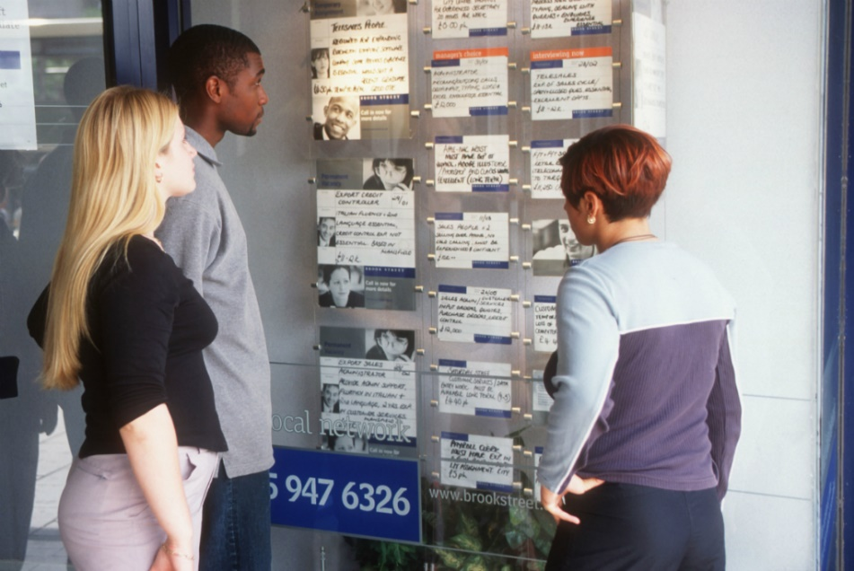
HOW TO HELP
Other ideas…
…playing sport…
Joining a club or Meetup group…
…or getting a job, if they don’t already have one

Slide 14
HOW TO HELP
In a recent analysis of people experiences of loneliness by the ONS, suggestions by young people themselves for tackling loneliness included:
Creating opportunities for social connection
Making it more acceptable to discuss loneliness at school and in society
Encouraging positive uses of social media
Preparing young people better to understand and address loneliness in themselves and others

Slide 15

THE ROLE OF TECHNOLOGY
Modern communication methods can be both a cause and cure for loneliness. Children and young people who are socially anxious can find online communication appealing because they can remain relatively anonymous. They can experiment with their identity and retain a sense of being in control.
One study found that the point of playing online games is often not to win, but to connect and feel a sense of virtual community.

Slide 16

THE ROLE OF TECHNOLOGY
But online communications can also cause negative feelings. Social media sites can facilitate bullying and can also induce feeling of FOMO (Fear Of Missing Out) – especially if users see posts from their peers where they are apparently having a great time.
To help young people navigate the social media landscape in a positive way, encourage them to pay attention to how their use of various social media platforms affect their mood.
Suggest they try avoiding the ones that make them feel sad or anxious, and see if those feelings subside.

Slide 17
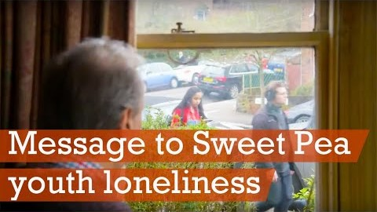
Message to Sweet Pea
A short film about youth loneliness by Exposure

Slide 18

The Loneliness Project
A short film about The Loneliness Project by
That’s Manchester TV

Slide 19
FOR MORE INFO…
PLEASE VISIT
www.ourwatch.org.uk/crimes-archive/youth-loneliness-and-isolation/
THANK YOU FOR LISTENING

