Slide 1
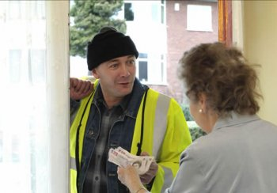
Scams and Older People
Please watch use the slide show option and watch from the beginning for the full effect
53% of people aged 65 and over say they have been targeted by criminals – that’s almost 6 million people

Slide 2
Scams Awareness Video
Please watch this short video created by Friends Against Scams to highlight the problem of scams in the UK…

Slide 3
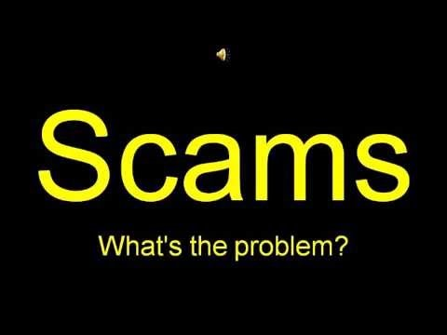
Scams Awareness Video

Slide 4

Doorstep Scams
Doorstep scams are where criminals turn up uninvited at your door and try to scam you. They can include:
Rogue traders – turn up uninvited and offer to do some work on your property
Bogus salespeople – try to pressure you into buying items you don’t need or are poor value for money
Fake charity fundraisers – may try to get your bank or credit card details in order to steal money from you later
Distraction burglars – often working in pairs, one will distract you whilst the other will gain access to your home via an alternative route
65% of doorstep scam victims are aged 75 and over!

Slide 5
Rogue Traders
Common phrases used by rogue traders include:
“My mate’s just kicked his ball over your fence, can we come and get it?”
“We’re working round the corner and noticed a loose tile on your roof”
“I’ve just done a job for your neighbour and they said your tree needed pruning”
“We’re in your area and it’s a special price if you agree today!”
“We’ve got material leftover from another job”

Slide 6
Top Tips
Trading standards advise all householders to NEVER BUY GOODS AND SERVICES ON THE DOORSTEP
Keep your front and back doors locked even when at home
Install a spyhole or door chain in your door
Display a ‘No Cold Calling’ sticker
Set up a password with your utility company – this will be used by anyone they send to your home so you know the caller is genuine.
If you answer the door and you don’t know the person, remember it’s not rude to ask them to leave. Here’s some things you can say:
“I don’t know who you are so please can you just leave”
“I never deal with cold callers at the door, please would you leave”

Slide 7
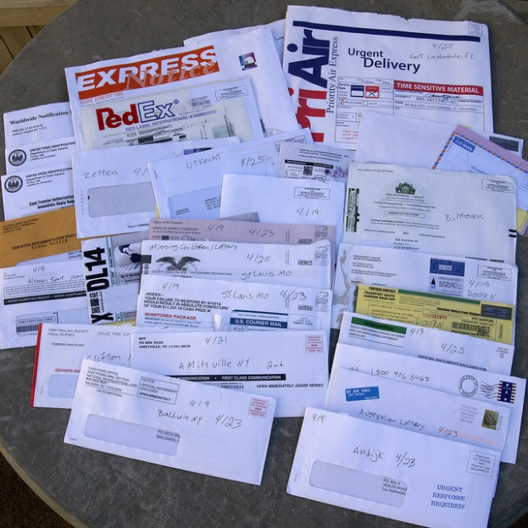
Postal Scams
Some people receive hundreds of scam letters each week. Common mail scams include:
Lottery, prize draw or 419 (advance fee fraud) scams – These mailings claim that you are entitled to a large sum of money, they just require a small fee for the money to be released.
Catalogue scams – catalogues arrive in the post selling vitamins, “miracle cures” or other items at so-called “bargain prices”. Products either never arrive or are of no value.
Clairvoyant scams – these claim they can make contact with a deceased relative or can predict your future – for a fee. Recently bereaved people can be especially susceptible.

Slide 8
Top Tips
REMEMBER: IF IT SEEMS TOO GOOD TO BE TRUE, IT USUALLY IS!
If you’ve been told you’ve won something in a raffle, prize draw or competition, think about whether you actually entered. If not, you can be sure it’s a scam.
If you are asked to pay a fee up-front in order to receive your money, it’s a scam.
Have you received a letter or catalogue out of the blue from a company or person you’ve never had contact with before? Chances are it’s a scam.
If you receive anything in the post that has any of these attributes, report the scam to Action Fraud, shred your personal details and put it in the bin.

Slide 9
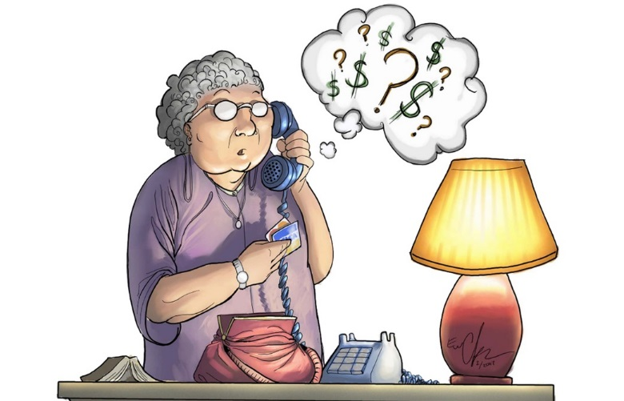
Telephone Scams
Criminals often use telephone scams to obtain personal details and/or financial information. Common telephone scams include:
Bank account scams - Someone posing as an official from your bank or the police, saying your bank account has been fraudulently accessed and so a new ‘safe’ account has been opened for you to transfer your money into
Courier scams – where criminals will call and pretend to be from your bank or utility company. They ask for your PIN number, and then send a ‘courier’ to your house to collect your bank card

Slide 10
Telephone Scams
Investment/Pension scams – where criminals cold-call you and try to sell you shares in ‘once-in-a-lifetime’ opportunities, often in exotic-sounding assets like wine, hotels or diamonds, which either don’t exist or are worthless.
Computer scams – where a caller tells you there’s a problem with your computer and offers to help fix it. After you’ve logged in and followed their instructions, the criminals install programs on your computer that steal your personal data.

Slide 11
Spot The Signs
Any one of these probably means it’s a scam call….
The caller asks you to transfer money to a new account or asks for your personal details such as a your 4-digit PIN. Banks will never do this.
The caller doesn’t give you time to think, tries to stop you speaking to someone else about it, or is insistent and makes you uncomfortable.
They say you’ve been a victim of fraud and offer to send a courier to your home to collect your cash, PIN, payment card or cheque book.

Slide 12

Top Tips
Install a call blocking unit
Don’t disclose personal information
If in doubt always hang up and phone the company using a number you know to be genuine. Be aware that criminals can hold the line open so either use another phone to make the call or phone a friend in-between!
Sign up to the Telephone Preference Service (free service). This service doesn’t stop scam calls but it will reduce the number of marketing calls you receive
Don’t be afraid to say no and hang up!

Slide 13

Investment/Pension Scams
Over-55s are at greatest risk
The average loss to an investment scam is over £32,000
Investment or pension scams can occur by email, phone or in the post and usually involve offers of worthless or non-existent shares in unregulated products such as wine, diamonds or crypto-currency.
Those with savings of over £10,000 are most likely to fall victim

Slide 14
Spot The Signs
Beware of offers that promise:
A free pension or investment review
Guaranteed returns
Low-tax or tax-free rates, including tax-free lump sums
Exotic-sounding and/or overseas investment
A once-in-a lifetime/never-before-available/when-it’s-gone-it’s-gone opportunity
Beware also of people that pressure you to sign up quickly, say they’re only making the offer available to you or ask you not to tell anyone else about it. They are criminals!

Slide 15
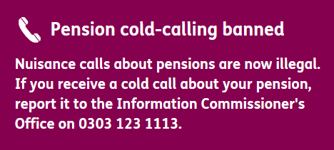
Top Tips
REMEMBER: IF IT SEEMS TOO GOOD TO BE TRUE, IT USUALLY IS!
Reject all unsolicited contact about your pension
If you get cold-called, the safest thing to do is to hang up. If you get unexpected offers by email or text, it’s best to simply report them
Don’t be rushed into making a decision, especially if they are claiming it is a time limited offer that won’t be around for much longer.
Check the Financial Conduct Authority (FCA) Warning List Tool to see if the investment opportunity on offer is a scam – this is a list of firms that the FCA knows is operating without permission or running scams

Slide 16
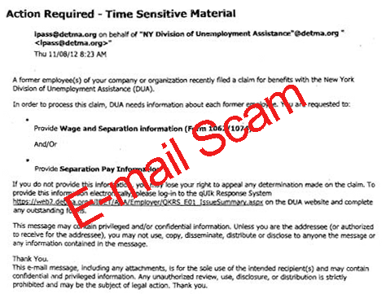
Online Fraud
Many criminals use email to target their victims with fraudulent offers or requests for personal information, but this is not the only way that criminals operate online. Here are some others:
Fake pop-ups in your online banking window
Retail websites offering fake goods
Links in emails or social media messages that, once clicked on, will infect your computer with a virus or malware that deletes or steals your data
Providing fraudulent Wi-Fi connections in public places

Slide 17

Email Scams
419 emails - Similar to 419 letters, you are asked to part with money in order to release a large sum. These have poor spelling and punctuation and are after your personal details.
Phishing & Pharming – These emails attempt to capture your personal and/or financial information. They may direct you to fake “official-looking” websites or directly request this information in the email.
Impersonation of UK official websites or UK officials - With an email message claiming you are due a refund and requesting your bank account details or directing you to a website link. e.g. HMRC tax rebate scam and the council tax scam.
Here are some common email scams:

Slide 18
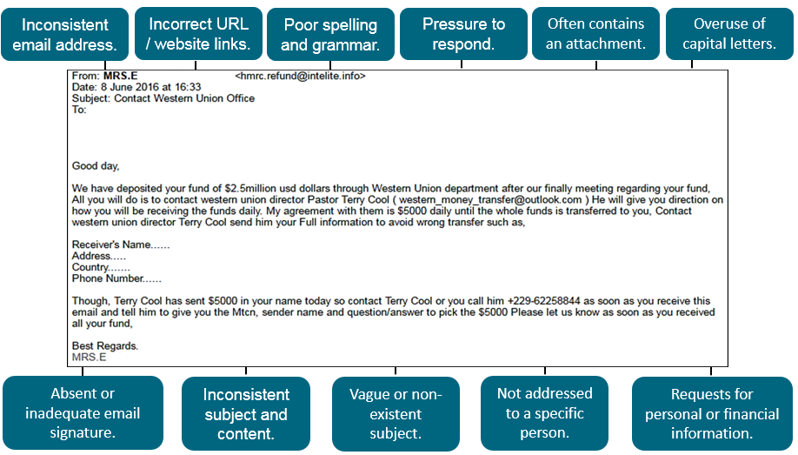
How To Spot A Scam Email
Here is an example of scam email, would you respond to this?

Slide 19
Top Tips
TRUST YOUR INSTINCTS. IF YOU FEEL AT ALL WARY OR SUSPICIOUS, YOU ARE PROBABLY RIGHT!
If you are even a tiny bit suspicious – check with someone you trust before responding or use a trusted source to contact the company to confirm it’s genuine
Never automatically click on a link in an unexpected text or email – this could contain a virus or harmful software that can steal your information
Make sure you use strong passwords and two factor authentication on all of your online accounts where possible and update passwords often

Slide 20

Romance Scams
Romance scams happen when someone pretends to have met their perfect match on an online dating site, but is in fact a criminal who is after the person’s money.
This type of scam is especially insidious because the criminal is manipulating and abusing the victim’s emotions. It plays on the need we all have for love and companionship and many people fall victim every year.
If the criminal is successful in persuading you to lend or give them money, they will usually come back with more and more reasons for needing more money.

Slide 21
Spot The Signs
Their story, or parts of it, change over time
They refuse to Skype or videocall you
Their grammar and spelling may be poor
The chat is friendly at first, but turns romantic very quickly
Eventually they ask you to lend them money
Their profile picture is very attractive

Slide 22
Top Tips
Just because there are some mean, dishonest people out there doesn’t mean you have to stop using dating sites altogether. You just have to follow some simple rules:
If you’re using social media sites such as Facebook, don’t accept friend or message requests from people you don’t know.
Don’t give away too many personal details about yourself online. Revealing your full name, date of birth and home address could lead to your identity being stolen.
NEVER send or receive money or give away your bank details to someone you’ve only met online.
Use reputable dating sites and keep communicating through their messaging service. Criminals will want you to quickly switch to text, social media or telephone so there is no evidence on the dating site of them asking you for money.

Slide 23
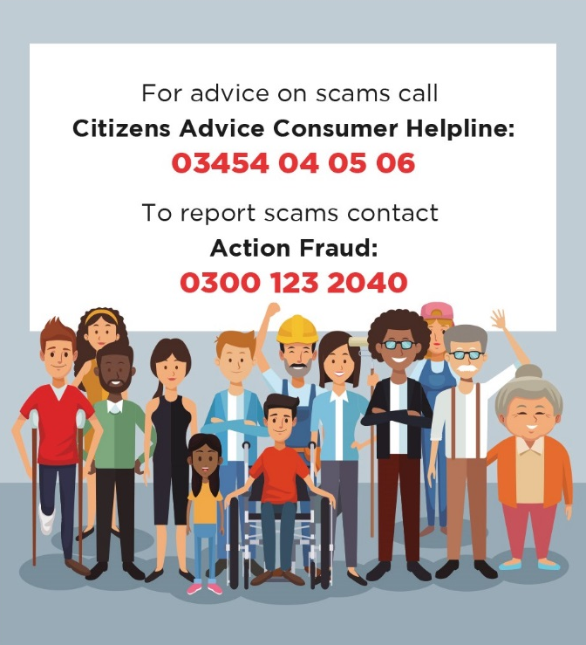
Report It!
If you do fall victim to a scam, don’t be embarrassed. It’s not your fault, the people behind scams are criminals and very good at what they do. Thousands of people become the victims of scams every year.
For advice on scams contact the Citizens Advice Consumer Helpline
Report scams to Action Fraud
For doorstep crime – If there is no immediate threat, report the crime via the non-emergency number 101. In an emergency call 999.

Slide 24
Next Steps
Thank you for taking the time to go through this presentation, we hope that you are now feeling #ScamAware. Please make a personal pledge to talk to your family, friends and neighbours about scams. A simple conversation could save people thousands of pounds! More information can be found at:
www.FriendsAgainstScams.org.uk – Friends Against Scams
www.thinkjessica.com – Think Jessica
www.citizensadvice.org.uk – Citizens advice
www.actionfraud.police.uk – Action Fraud
www.fca.org.uk – The Financial Conduct Authority

