Slide 1
‘PROTECT YOUR Pa$$W0rD’:
cybercrime 2020 campaign
Social media pack, November 2020

Slide 2
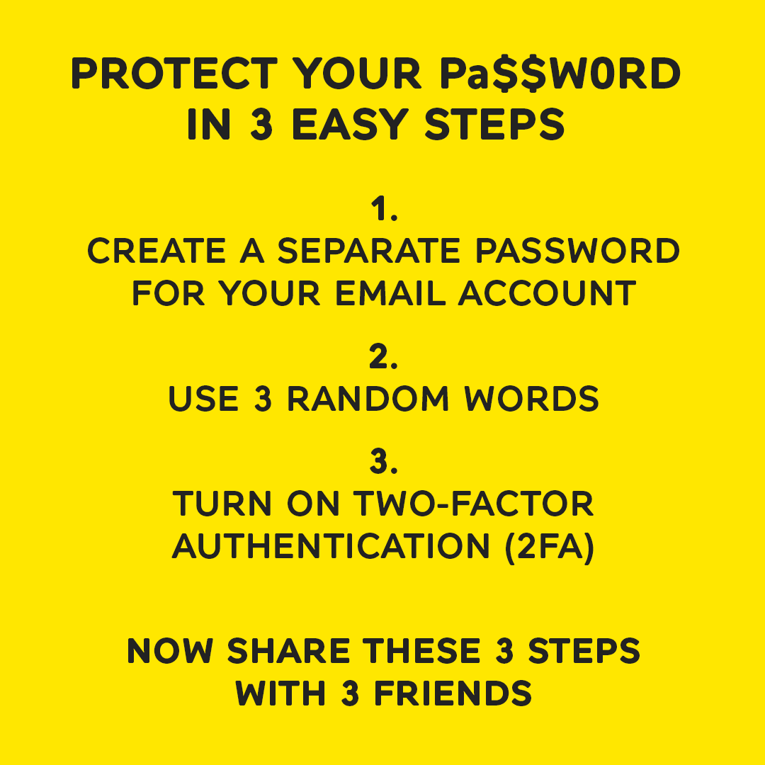
Introduction
As we spend more time at home on our online devices, over one third (34%) of people now say that they’re more concerned about cybercrime than physical crime.
We know there is a sea of information out there around how to best protect yourself online which can quickly get confusing.
As part of our Cyberhood Watch initiative, launched in 2019 in partnership with Avast, we have launched a PROTECT YOUR Pa$$W0Rd campaign.
The fresh, thumb-stopping social campaign is aimed at providing everyone (Neighbourhood Watch members, and non-members alike) with 3 easy steps to be more secure online. We are encouraging everyone to share these 3 steps with their family, friends and neighbours.
The campaign launches on 9th November 2020 and runs for a month. We are asking for your help to promote our campaign during this time however you can use the campaign materials to promote safe passwords anytime beyond this.
Our PROTECT YOUR Pa$$W0Rd campaign page on our website supports you to deliver the campaign and our Password protection crime-prevention page provides clear and simple guidance on the 3 steps.
For more information see our Press Release which you are welcome to share with any press contacts you may have.

Slide 3
Campaign assets: Pa$$W0rD C0NFU5#0N
SUGGESTED WORDING
Managing your online passwords can be overwhelming - from which characters to use to remembering what it is in the first place! #ProtectyourPaSSW0rD with our 3 easy steps to help you stay safe online. www.ourwatch.org.uk/passwords
Tag Neighbourhood Watch with @N_watch on Twitter, @ourwatch on Facebook, and @neighbourhood.watch.insta on Instagram posts
Download Animation video:
Instagram / Twitter video
Facebook video
Download static image:
Instagram / Twitter image
Facebook image
Place your cursor over the video to see a play button.
Please promote our PROTECT YOUR Pa$$W0rD campaign by sharing our social media videos and images and suggested wording.

Slide 4
Campaign assets: PICK 4 MATES
SUGGESTED WORDING
Cybercrime affects everyone, including young people: 1 in 5 of us will be victims. #ProtectyourPaSSW0rD is a quick and easy way to protect yourself and prevent anyone accessing your bank details or private photos! Just follow our 3 easy steps to www.ourwatch.org.uk/passwords
Tag Neighbourhood Watch with @N_watch on Twitter, @ourwatch on Facebook, and @neighbourhood.watch.insta on Instagram posts
Download Animation video:
Instagram / Twitter video
Facebook video
Download static image:
Instagram / Twitter image
Facebook image
Place your cursor over the video to see a play button.
Please promote our PROTECT YOUR Pa$$W0rD campaign by sharing our social media videos and images and suggested wording.

Slide 5
Campaign assets: 3 EASY STEPS
SUGGESTED WORDING
#ProtectyourPaSSW0rD using our 3 steps for a quick and easy way to protect from you cybercrime. Just follow our 3 easy steps, and then share this post with at least 3 others. www.ourwatch.org.uk/passwords
Tag Neighbourhood Watch with @N_watch on Twitter, @ourwatch on Facebook, and @neighbourhood.watch.insta on Instagram posts
Download image:
Instagram / Twitter image
Facebook image
Alternative copy for ALL posts
Help us lock reduce cybercrime Introducing our new #ProtectyourPa$$W0rD campaign - it only takes 3 easy steps www.ourwatch.org.uk/passwords
Neighbourhood Watch need your help to make sure whole communities #ProtectyourPa$$W0rD Find free resources to use and share here www.ourwatch.org.uk/passwords
1 in 5 of us will be victims of cybercrime. Don’t be the 1. #ProtectyourPa$$W0rD and take and share these 3 easy steps: www.ourwatch.org.uk/passwords
If strengthening your passwords is something you keep putting off, we’ve got 3 easy steps to help #ProtectyourPa$$W0rD www.ourwatch.org.uk/passwords
Don’t forget to tag Neighbourhood Watch with @N_watch on Twitter, @ourwatch on Facebook, and @neighbourhood.watch.insta on Instagram posts
Please promote our PROTECT YOUR Pa$$W0rD campaign by sharing our social media videos and images and suggested wording.

Slide 6
Suggested schedule for posting
We recommend the suggested schedule for posting however this is completely flexible.
For more information on the campaign please contact Deborah Waller, Senior Communications and Digital Manager at Neighbourhood Watch Network on deborah.waller@ourwatch.org.uk or 07495 415380.
 | w/c 9th Nov | w/c 16th Nov | w/c 23rd Nov | w/c 30th Nov
Facebook (twice per week) | ‘Password confusion’ video ‘3 Easy steps’ image | ‘Pick 4 mates’ video ‘Password confusion’ image | ‘Password confusion’ video ‘Pick 4 mates’ image | ‘Pick 4 mates’ video ‘3 Easy steps’ image
Instagram (twice per week) | ‘Password confusion’ video ‘3 Easy steps’ image | ‘Pick 4 mates’ video ‘Password confusion’ image | ‘Password confusion’ video ‘Pick 4 mates’ image | ‘Pick 4 mates’ video ‘3 Easy steps’ image
Twitter (up to daily) | ‘Password confusion’ video ‘Password confusion’ image ‘3 Easy steps’ image ‘Pick 4 mates’ video ‘Pick 4 mates’ image | ‘Pick 4 mates’ video ‘Pick 4 mates’ image ‘3 Easy steps’ image ‘Password confusion’ video ‘Password confusion’ image | ‘Password confusion’ video ‘Password confusion’ image ‘3 Easy steps’ image ‘Pick 4 mates’ video ‘Pick 4 mates’ image | ‘Pick 4 mates’ video ‘Pick 4 mates’ image ‘3 Easy steps’ image ‘Password confusion’ video ‘Password confusion’ image
Thank you for helping us stay 3 steps ahead of cybercrime!

