Slide 1
LET’S STOP DISABILITY HATE CRIME

Slide 2
What is Disability Hate Crime?
“Any criminal offence which is perceived by the victim or any other person to be motivated by hostility or prejudice based on a person’s disability or perceived disability”
NPCC / CPS definition

Slide 3
Disability Hate Incident (non crime)
“Any non-crime incident which is perceived by the victim or any other person to be motivated by hostility or prejudice based on a person’s disability or perceived disability”
NPCC / CPS definition

Slide 4
Key elements of Disability Hate Crime and Hate Incidents
Hostility
Prejudice
Perceived (not just perception that is a hate incident or crime, perceived disability)
Disability, but may also be accompanied by racial, religious, sexual orientation or transgender hate

Slide 5
Hostility
No definition within legislation for hostility
Dictionary definition, e.g. antagonism, unfriendliness, malice, unkindness, spitefulness, hatred

Slide 6
Prejudice
Oxford Dictionary definition: “A pre-conceived opinion that is not based on reason or actual experience”
Includes a dislike, hostility or unjust behaviour deriving from pre-conceived and unfounded opinions

Slide 7
Perceived
Anyone can perceive that an incident is a hate incident or hate crime.
The apparent lack of evidence of hate motivation is not relevant for recording it as a hate incident or crime.
Can be perceived that a person was disabled (etc), but victim does not have to be.

Slide 8
Mate Crime
The exploitation, abuse or theft from any vulnerable person by those they consider to be their friends.
Often referred to as 'fake friends'.

Slide 9
Common factors
Previous disability hate incidents or crimes
Escalating in severity and frequency
‘Fake friends’
Multiple perpetrators condoning and encouraging
False accusations of being paedophiles or informants
Sustained attacks
Excessive violence
Opportunistic becomes systematic and regular targeting
Cruelty, humiliation and degradation

Slide 10
Case Study: Miss J
She has both mental health and mobility problems
She’s a single mother to two small children
She’s on state benefits.
She’s what is termed as vulnerable
A gang of boys on the estate have been harassing her over the past few months
“The police looked at me because I’m grown woman being
bullied … and say ‘just deal with it’ but I can’t
because when I’m face to face with eight or nine
people all giving me verbal abuse…”

Slide 11
Miss J’s fears of reporting
Not being believed
False allegations from the perpetrators
Losing control and fighting back
Potentially losing her kids if she does

Slide 12
Why stopping Hate Crime is so important
Has a great impact on the victim
Affects the wider community
Has an impact on community cohesion
Affects confidence in the Police and other agencies
Prevents escalation in seriousness
The cost to society is massive.
Notes:
12

Slide 13
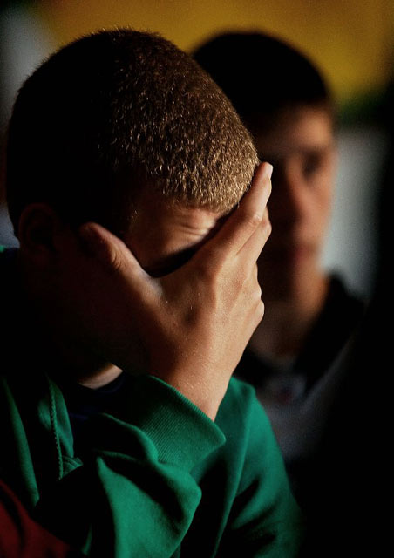
Impact and Effect
Fear
Reluctance to leave home
Homes become fortress
Isolation
Changes in routines
Family breakdown
Acceptance of victimisation
Loss of friends / friends do not visit
Impact on health and wellbeing

Slide 14
Challenges of Disability Hate Crime
Massive under reporting – including Anti-Social Behaviour incidents
Lack of understanding
Is it ‘vulnerability’ or ‘hate’?
Context of disability hate crime is different from other hate crimes

Slide 15
How do you report a Disability Hate Crime or Incident?
In an emergency call the police on 999
If it is not an emergency call the police on 101
If you wish to report in confidence call Crimestoppers on 0800 555 111
Use the True Vision ‘Report It’ form https://beta.met.police.uk/true-vision-report-hate-crime/

Slide 16
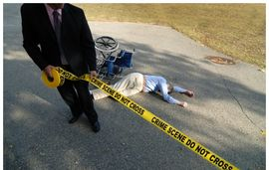
Report it to stop it!
Stephen Brookes MBE
Disability Hate Crime Network
E mail – DHCN2007@btinternet.com

